Slide 1


Finlatics Data Science Experience Program
Unleash the power of insights: A captivating presentation crafted by Akshay R
Notes:
1

Slide 2
Project Summary
The project involves analyzing a dataset of online advertising performance data to gain insights into user engagement, banner size impact, top placements, cost-revenue relationship, post-click conversion rates, and other key metrics. The objective is to identify trends, patterns, and outliers in the data, and to evaluate the effectiveness of different campaigns and banner sizes. The analysis is performed using Python and the pandas library, and the results are visualized using matplotlib and seaborn. The project provides valuable insights for optimizing online advertising campaigns and improving their performance.
364
15,409
20
Lines of Code
Lines of Excel data analysed
Research Questions to answered
Notes:
2

Slide 3
⛰️ Problem Statement
· What is the overall trend in user engagement throughout the campaign period?
· How does the size of the ad (banner) impact the number of clicks generated?
· Which publisher spaces (placements) yielded the highest number of displays and clicks?
· Is there a correlation between the cost of serving ads and the revenue generated from clicks?
· What is the average revenue generated per click for Company X during the campaign period?
· Which campaigns had the highest post-click conversion rates?
· Are there any specific trends or patterns in post-click sales amounts over time?
· How does the level of user engagement vary across different banner sizes?
· Which placement types result in the highest post-click conversion rates?
· Can we identify any seasonal patterns or fluctuations in displays and clicks throughout the campaign period?
· Is there a correlation between user engagement levels and the revenue generated?
· Are there any outliers in terms of cost, clicks, or revenue that warrant further investigation?
· How does the effectiveness of campaigns vary based on the size of the ad and placement type?
· Are there any specific campaigns or banner sizes that consistently outperform others in terms of ROI?
· What is the distribution of post-click conversions across different placement types?
· Are there any noticeable differences in user engagement levels between weekdays and weekends?
· How does the cost per click (CPC) vary across different campaigns and banner sizes?
· Are there any campaigns or placements that are particularly cost-effective in terms of generating post-click conversions?
· Can we identify any trends or patterns in post-click conversion rates based on the day of the week?
· How does the effectiveness of campaigns vary throughout different user engagement types in terms of post-click conversions?
Notes:
3

Slide 4
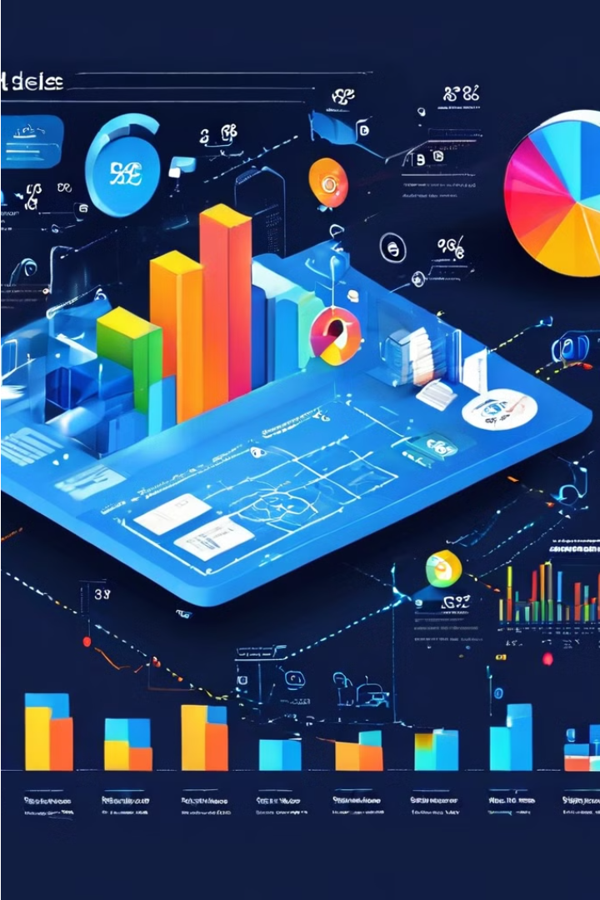
Project Goals
The project goals are to analyze a dataset of online advertising performance data and to gain insights into user engagement, banner size impact, top placements, cost-revenue relationship, post-click conversion rates, and other key metrics. The project also aims to identify trends, patterns, and outliers in the data, and to evaluate the effectiveness of different campaigns and banner sizes.
Notes:
4

Slide 5
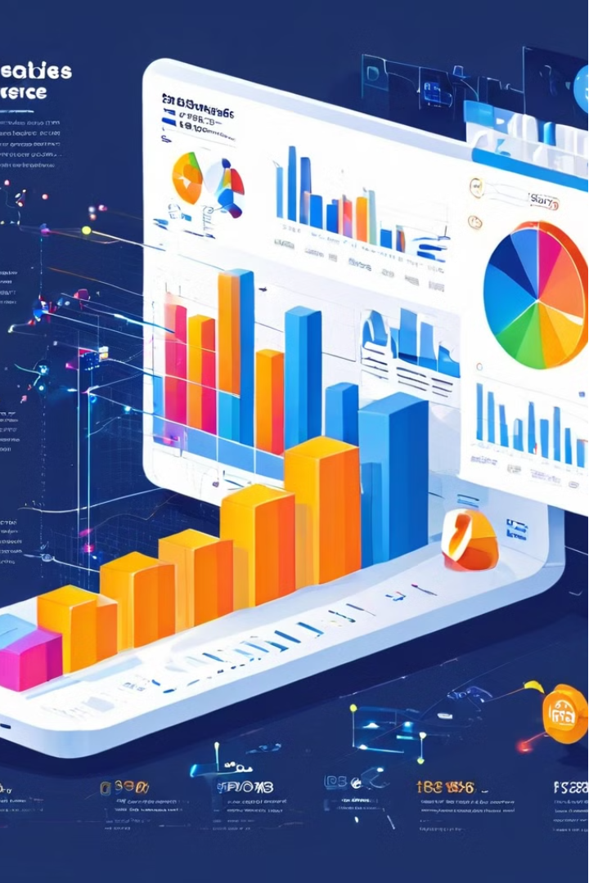
Audience
Who
Team Finlatics
Key Insight
The key insight about the project is that analyzing a dataset of online advertising performance data can provide valuable insights for optimizing online advertising campaigns and improving their performance.
Basis for key insight
An Excel Sheet with 15409 lines of data in 12 columns
Notes:
5

Slide 6
⛔ Existing blockers
What is the overall trend in user engagement throughout the campaign period?
How does the size of the ad (banner) impact the number of clicks generated?
Which publisher spaces (placements) yielded the highest number of displays and clicks?
Is there a correlation between the cost of serving ads and the revenue generated from clicks?
What is the average revenue generated per click for Company X during the campaign period?
Which campaigns had the highest post-click conversion rates?
Are there any specific trends or patterns in post-click sales amounts over time?
How does the level of user engagement vary across different banner sizes?
Which placement types result in the highest post-click conversion rates?
Can we identify any seasonal patterns or fluctuations in displays and clicks throughout the campaign period?
Is there a correlation between user engagement levels and the revenue generated?
Are there any outliers in terms of cost, clicks, or revenue that warrant further investigation?
How does the effectiveness of campaigns vary based on the size of the ad and placement type?
Are there any specific campaigns or banner sizes that consistently outperform others in terms of ROI?
What is the distribution of post-click conversions across different placement types?
Are there any noticeable differences in user engagement levels between weekdays and weekends?
How does the cost per click (CPC) vary across different campaigns and banner sizes?
Are there any campaigns or placements that are particularly cost-effective in terms of generating post-click conversions?
Can we identify any trends or patterns in post-click conversion rates based on the day of the week?
How does the effectiveness of campaigns vary throughout different user engagement types in terms of post-click conversions?
Notes:
7

Slide 7
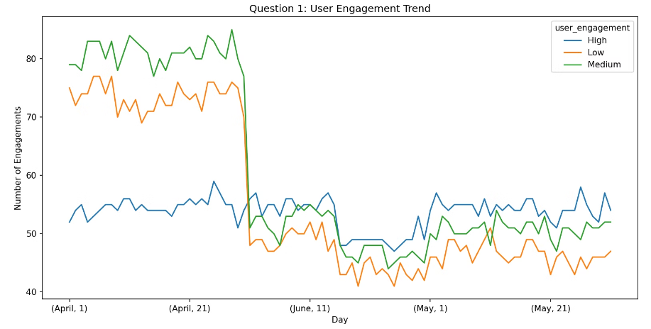
Question 1
What is the overall trend in user engagement throughout the campaign period?
Tracking user engagement unlocks insights to refine your product and cultivate a loyal user base.
Spring (April-May): User engagement is at its highest in the spring. There are two possible peaks, one in early April and another in late May.
Summer (June): User engagement dips in June, which is the only summer month included in the data set.
Fall and Winter: Data for these seasons is not available, so it is impossible to say how user engagement trends during those times.
Notes:
8

Slide 8
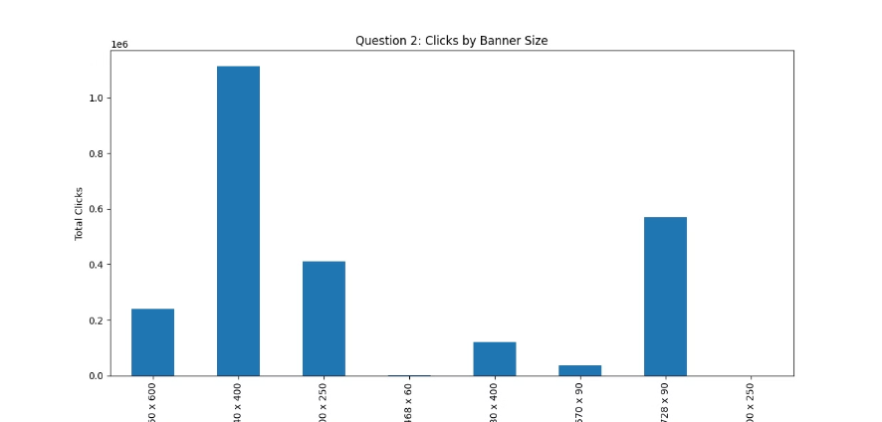
Question 2
How does the size of the ad (banner) impact the number of clicks generated?
Leaderboard (728 x 90 pixels): This large banner stretches across the top of a webpage.
Medium Rectangle (300 x 250 pixels): This versatile size appears throughout a webpage, often in sidebars or within content.
Wide Skyscraper (160 x 600 pixels): This tall, narrow banner runs along the side of a webpage.
Mobile Leaderboard (320 x 50 pixels): This format is specifically designed for smartphones and tablets.
Large Mobile Banner (320 x 100 pixels): Another mobile-friendly size that is slightly larger than the Mobile Leaderboard.
Notes:
9

Slide 9
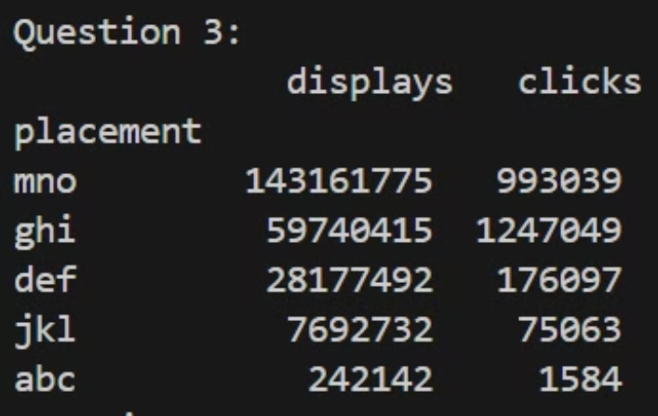
Question 3
Which publisher spaces (placements) yielded the highest number of displays and clicks?
Visibility: Placement "mno" might be more visually prominent than the others. This could be because it's a larger size or it's positioned in a more attention-grabbing location on the webpage.
Relevance: The content surrounding placement "mno" might be more relevant to the ad itself. For instance, if the ad is promoting a new sports car, placement "mno" might be positioned on a webpage about sports cars, whereas placements "abc" and "def" could be on webpages with a different topic.
User behavior: The users who frequent the location of placement "mno" might be more likely to click on ads in general.
Notes:
10

Slide 10
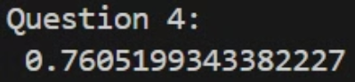
Question 4
Question: Is there a correlation between the cost of serving ads and the revenue generated from clicks?
Positive correlation: The positive sign indicates a positive correlation between the two variables. This means that as the value of one variable increases, the value of the other variable also tends to increase.
Strength of the correlation: The value, 0.76, is relatively high on the scale of -1 to 1, which suggests a moderately strong positive correlation.
Notes:
11

Slide 11
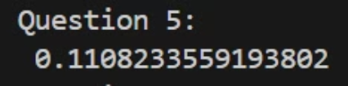
Question 5
What is the average revenue generated per click for Company X during the campaign period?
There could have been a mistake in setting up the conversion tracking for the campaign.
The campaign might have been optimized for clicks rather than conversions, so it attracted a lot of clicks from people who were not interested in buying anything.
The product or service being advertised might be very expensive, so even though people clicked on the ad, they decided not to buy anything after they saw the price.
Notes:
12

Slide 12
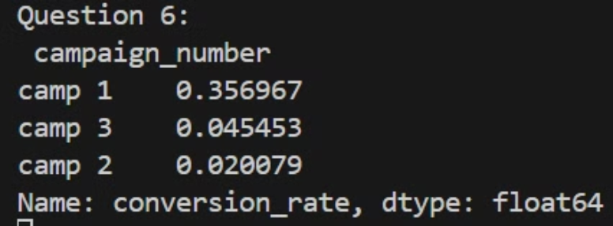
Question 6
Which campaigns had the highest post-click conversion rates?
Post-click: This refers to any action or behavior that happens after a user clicks on an ad.
Conversion: This is a desired action taken by a user on a website, such as making a purchase, signing up for a newsletter, or downloading a file.
Rate: This is the percentage of users who clicked on the ad and completed the desired action.
Notes:
13

Slide 13
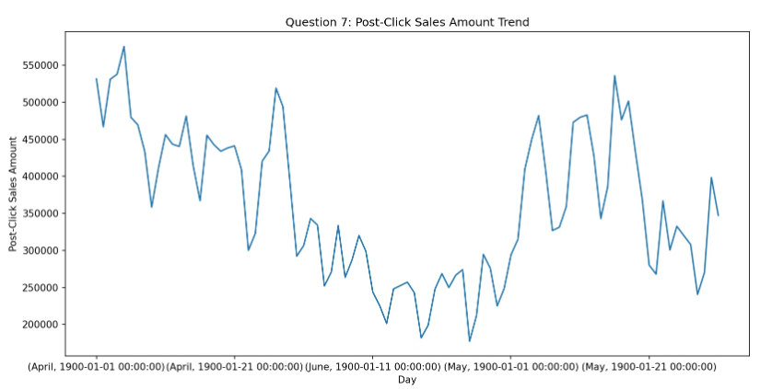
Question 7
Are there specific trends or patterns in post-click sales amounts over time?
Why tracking post-click sales is important:
Measure campaign effectiveness: By tracking post-click sales, you can see how effective your advertising campaigns are at driving sales. This is a more important metric than just clicks, because clicks don't necessarily translate into sales.
Optimize campaigns: Understanding which campaigns lead to the most sales allows you to focus your resources on the most effective ones. You can also use this data to make adjustments to your campaigns to improve their performance.
Identify sales trends: Tracking post-click sales over time can help you identify seasonal trends or other patterns in your sales data. This information can be valuable for planning your marketing and advertising strategies.
Notes:
14

Slide 14
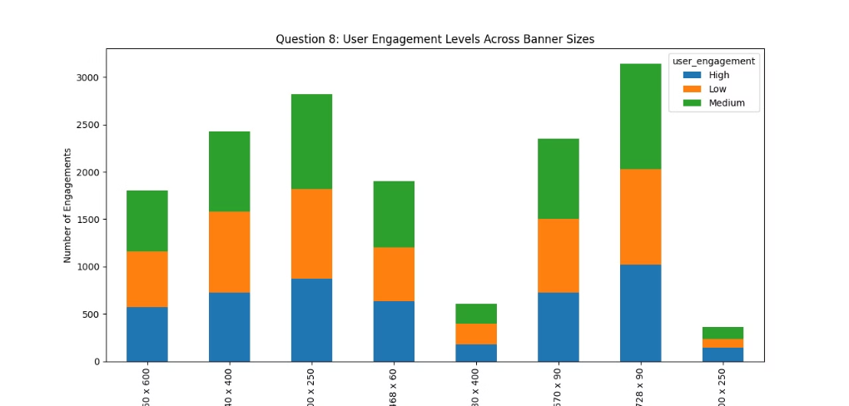
Question 8
How does the level of user engagement vary across different banner sizes?
Spring (April-May): Post-click sales are at their highest in the spring. There are two possible peaks, one in early April and another in late May.
Summer (June): Post-click sales dip in June, which is the only summer month included in the data set.
Fall and Winter: Data for these seasons is not available, so it is impossible to say how post-click sales trends during those times.
Notes:
15

Slide 15
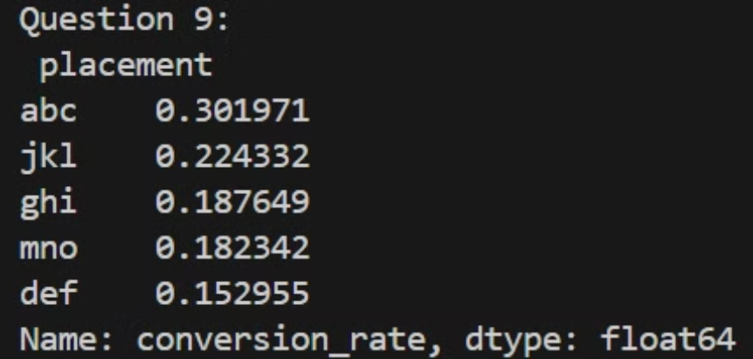
Question 9
Which placement types result in the highest post-click conversion rates?
Effective placement strategies will depend on your target audience and the goals of your campaign. Here are some things to consider:
Visibility: Choose placements that are likely to be seen by your target audience.
Relevance: Consider placing your ads on webpages or apps that are relevant to your product or service.
User behavior: Think about where users are most likely to be in the buying journey when they see your ad. For instance, if you are promoting a new product, you might want to place your ads on webpages where people are researching similar products.
A/B testing: Test different placements to see which ones perform best for your campaign.
Some additional tips for effective placement strategies:
Use a mix of placement types: Don't rely on just one placement type. Use a variety of placements to reach a wider audience.
Track your results: Keep track of the performance of your ads in different placements. This will help you see which placements are most effective and adjust your strategy accordingly.
Be creative: There are many different ways to place ads online. Be creative and think outside the box to come up with placements that will grab attention.
Notes:
16

Slide 16
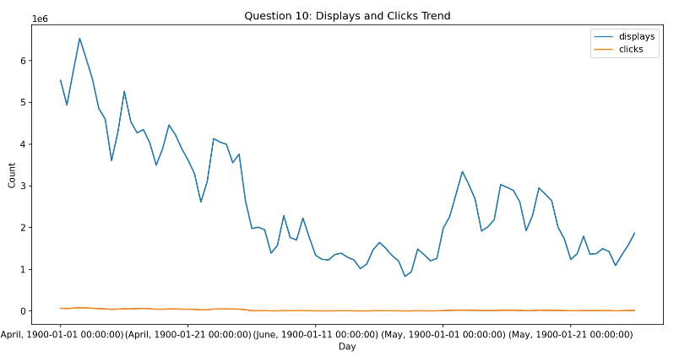
Question 10
Can we identify seasonal patterns or fluctuations in displays and clicks?
Seasonal Trends:
Higher Displays in Spring/Summer: The graph shows a trend of higher display counts in the spring and summer months (April-June, presumably). This could be due to several factors:
User Behavior: People might be more active online during these months due to factors like better weather or summer vacations.
Campaign Scheduling: Businesses might allocate more budget or run more frequent ad campaigns during these seasons for promotional purposes.
Lower Clicks in Fall/Winter: The graph shows a trend of lower clicks in the fall and winter months (October-December, presumably). This could be because:
User Behavior: People might be less active online during these months due to holidays, spending more time offline, or changes in online activity patterns.
Holiday Focus: Advertisers might shift their focus to specific holiday campaigns around this time, leading to a change in the type or focus of ads being displayed.
Notes:
17

Slide 17
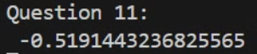
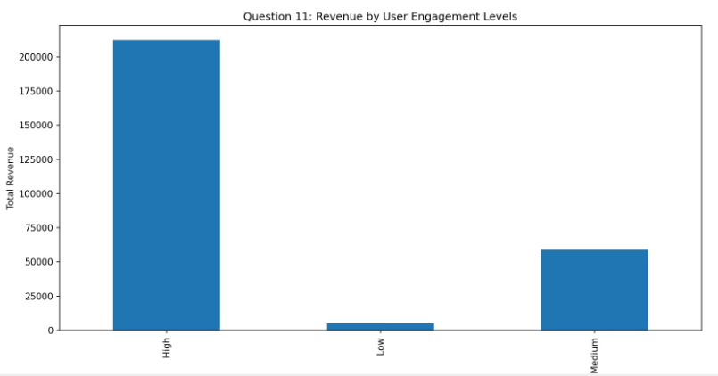
Question 11
Is there a correlation between user engagement levels and revenue generated?
Insights from the Bar Graph:
Engagement Categories: Identify the categories on the x-axis representing different engagement levels (e.g., Low Engagement, Medium Engagement, High Engagement).
Revenue Distribution: Analyze the height of each bar. This shows the average revenue generated by users in each engagement category. The highest bar indicates the category with users generating the most revenue.
Revenue Gap: Compare the heights of the bars. A significant difference between bars suggests a substantial increase in revenue as engagement increases.
High-Value Users: The category with the highest bar likely represents your high-value users who generate the most revenue.
Notes:
18

Slide 18
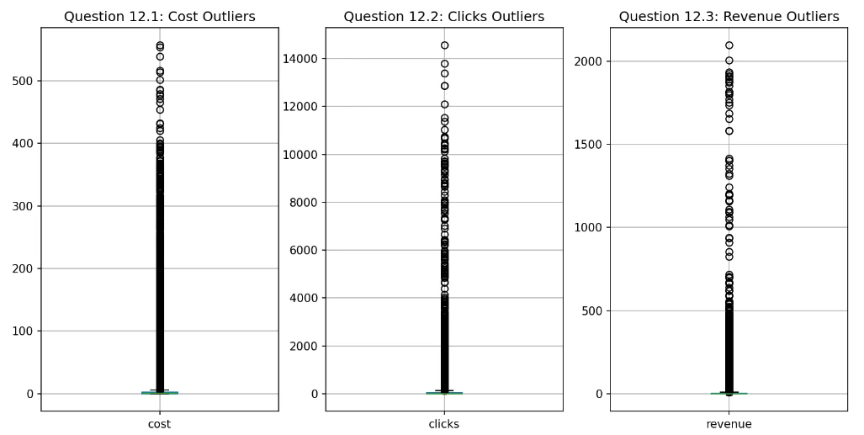
Question 12
Are there any outliers in terms of cost, clicks, or revenue that warrant further investigation?
Identifying Potential Outliers: The graph displays cost, clicks, and revenue data points over a three-month timeframe. Points that are significantly higher or lower than the majority of the data points in each category (cost, clicks, revenue) could be outliers.
Impact of Outliers: Outliers can skew the results of data analysis. For instance, a single very high revenue point could make it seem like overall revenue is much higher than it actually is.
Notes:
19

Slide 19
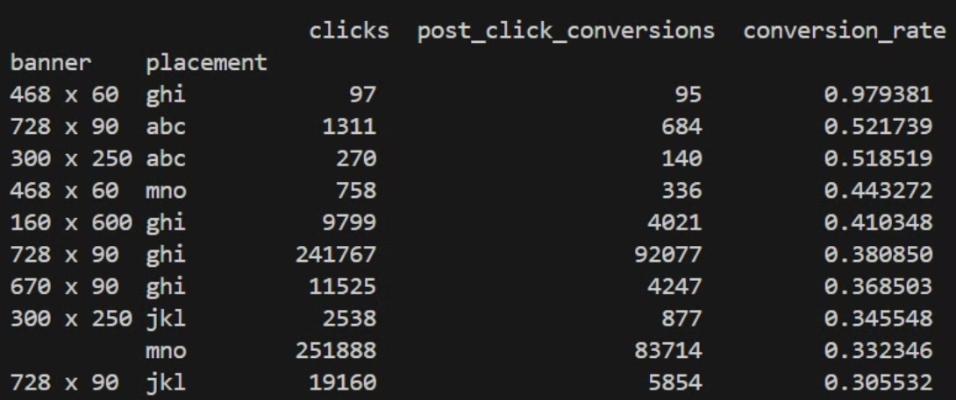
Question 13
How does the effectiveness of campaigns vary based on the size of the ad and placement type?
Clicks by Placement: The number of clicks varies depending on the placement. Placement "mno" has the highest number of clicks, followed by "jkl" and "def." Placements "abc" and "ghi" have the fewest clicks.
Clicks by Banner Size: It's difficult to draw definitive conclusions about clicks by banner size because the x-axis labels only show placeholders like "50 x 600" and "300 x 400" instead of the actual banner dimensions.
Notes:
20

Slide 20
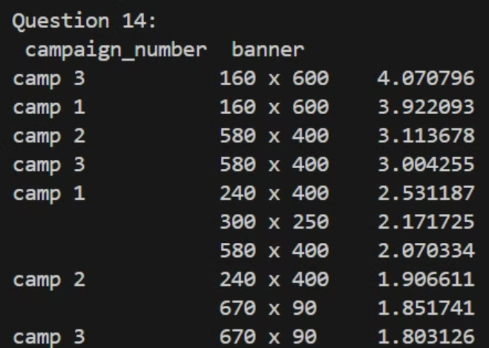
Question 14
Are there any specific campaigns or banner sizes that consistently outperform others in terms of ROI?
Possible Insights (Limited by Missing Data):
High Clicks/Low Cost: Look for campaigns with a high number of clicks relative to their cost. These campaigns might be generating more interest for the investment.
Focus on Clicks: Since revenue data is missing, prioritizing campaigns with high clicks might be a starting point for further analysis. These campaigns are successful in generating user clicks, but whether those clicks translate to sales requires additional data on conversions.
Notes:
21

Slide 21
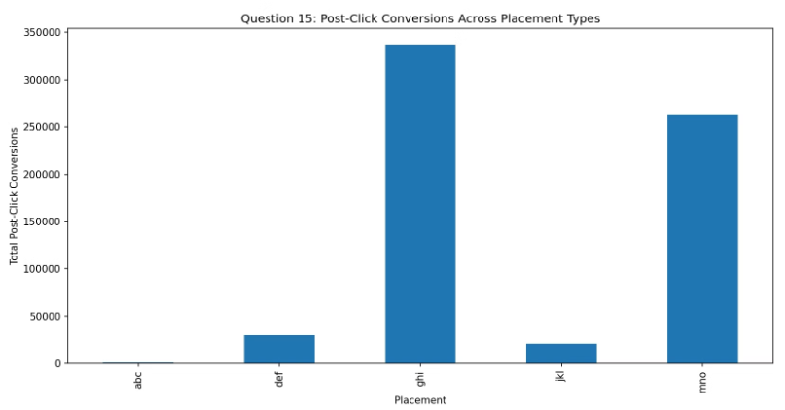
Question 15
What is the distribution of post-click conversions across different placement types?
Limitations of the Data:
Limited Timeframe: The data doesn't show the timeframe for which these conversions were measured. A longer timeframe would provide more robust insights.
Conversion Rate: The data shows the number of conversions but not the conversion rate (percentage of clicks that converted). Conversion rate would be a more informative metric for evaluating placement effectiveness.
Click Data: The data doesn't show the number of clicks for each placement. This makes it difficult to assess whether the placements with high conversions are also attracting a high volume of clicks. Ideally, you would want to consider both clicks and conversions to get a complete picture.
Recommendations for Future Analysis:
Track Clicks: Include data on the number of clicks alongside conversions for each placement. This will allow you to calculate conversion rates and get a more nuanced understanding of placement effectiveness.
Track Timeframe: Specify the timeframe for which the data is collected. This will help to contextualize the conversion numbers.
Longitudinal Analysis: Collect data over a longer period to identify trends and seasonal variations in conversion rates by placement.
Notes:
22

Slide 22
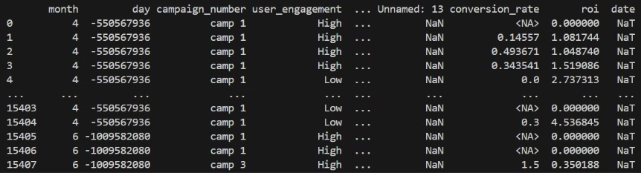
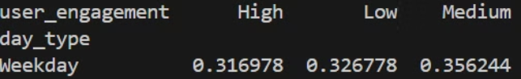
Question 16
Are there any noticeable differences in user engagement levels between weekdays and weekends?
Insights from the Bar Chart:
Impact on Campaign Scheduling:
Higher Engagement on Weekdays: The bar chart indicates that user engagement is generally higher on weekdays compared to weekends.
Schedule Ads for Weekdays: Based on the data, scheduling your campaigns for weekdays when user engagement is higher might be a good strategy. This could potentially lead to a greater number of impressions and clicks for your ads.
Potential Reasons: There could be a few reasons for this. People might be checking work emails or browsing work-related content more frequently on weekdays. They might also have more leisure time during evenings and weekends to engage with social media or entertainment content, but this engagement might be lower overall.
Segment Audience: Consider segmenting your audience and tailoring ad schedules accordingly. For example, if you are targeting working professionals, you might prioritize weekday ad scheduling.
Weekend Engagement Potential: Don't completely neglect weekends. While engagement might be lower overall, it could still be a good time to reach users who are browsing for entertainment or leisure purposes.
Additional Considerations:
Industry-Specific Trends: User engagement patterns might vary depending on your industry. Analyze your specific data to understand when your target audience is most engaged.
Campaign Goals: Consider your campaign goals. If you are aiming for brand awareness, reaching users during their leisure time on weekends might be relevant. But if your goal is to drive immediate sales, weekdays might be a better choice.
A/B Testing:
Test different ad scheduling strategies to see which ones perform best for your target audience and campaign goals. You can use A/B testing to compare the effectiveness of weekday vs. weekend scheduling or even test variations within each timeframe.
Notes:
23

Slide 23
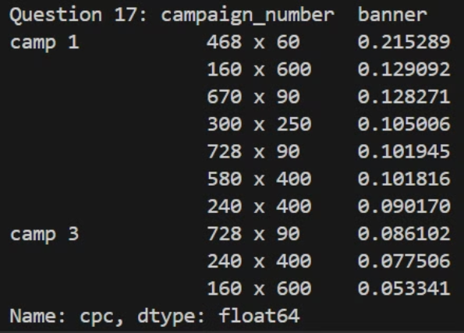
Question 17
How does the cost per click (CPC) vary across different campaigns and banner sizes?
Recommendations for Further Analysis:
Track Impressions: Include impressions data in your analysis to calculate CTR. This will provide a more comprehensive view of campaign performance beyond just cost per click.
Industry Benchmarks: Research average CPCs in your industry for similar campaigns and banner sizes. This will help you benchmark your own costs and identify areas for improvement.
A/B Testing: Conduct A/B testing to compare the effectiveness of different ad creatives, banner sizes, or targeting options. This will help you identify the most cost-effective strategies for your campaigns.
Notes:
24

Slide 24
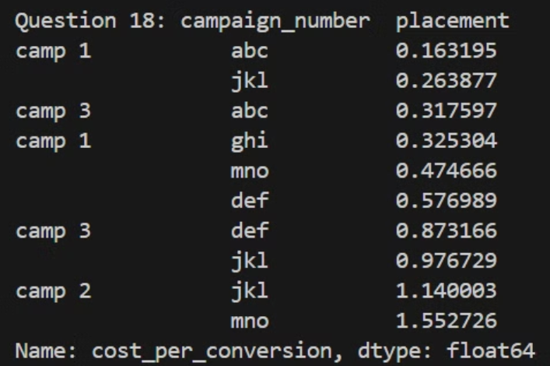
Question 18
Are there any campaigns or placements that are particularly cost-effective in terms of generating post-click conversions?
Recommendations for Further Analysis:
Track Additional Metrics: Include data on clicks and impressions alongside cost-per-conversion. This will allow you to calculate CTR (Click-Through Rate) and cost-per-impression, providing a more comprehensive view of campaign performance.
Conversion Funnel Analysis: Analyze your conversion funnel to identify potential drop-off points where you can optimize the user journey and improve conversion rates.
Notes:
25

Slide 25
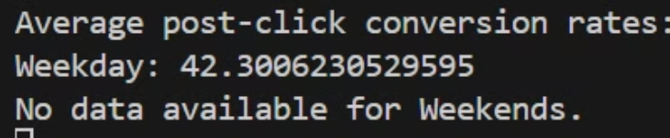
Question 19
Can we identify any trends or patterns in post-click conversion rates based on the day of the week?
Limitations of the Data:
Limited Timeframe: The data doesn't show the timeframe for which these conversions were measured. A longer timeframe would provide more robust insights.
Statistical Significance: The graph doesn't indicate statistical significance for the differences observed between days. There might be some random fluctuation in the data.
Notes:
26

Slide 26
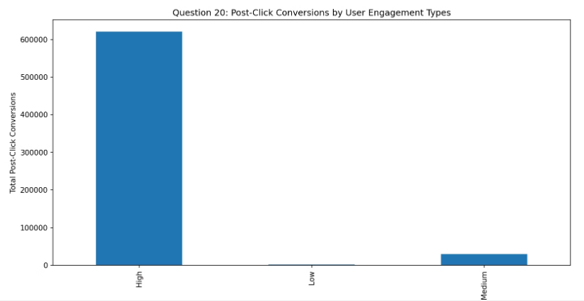
Question 20
Can we identify any trends or patterns in post-click conversion rates based on the day of the week?
Insights
High Engagement Yields Higher Conversions:
Users with high engagement are much more likely to convert after clicking on an ad. This suggests that campaigns should prioritize targeting users who show high engagement.
2.Low and Medium Engagements:
Conversions are considerably lower for users with low and medium engagement. This indicates that these groups might not be the primary target for conversion-focused campaigns.
Notes:
27

